Slide 1
Title with Pictures Layout
Subtitle
Notes:
NOTE: To replace a picture, just select and delete it. Then use the Insert Picture icon to replace it with one of your own!

Slide 2
Moist Cooking Methods
Boiling
Poaching
Steaming
Stewing
Braising
Frying
Roasting
All these Methods of Cooking require a liquid to cook the ingredients in

Slide 3
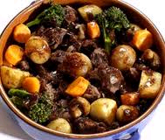
Types of Dishes that would typically be cooked using a moist cooking methods
Soups
Sauces
Stews
Vegetables
Fish
Cheaper cuts of meat
Fruit

Slide 4
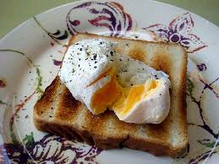
Poaching
Poaching is cooking in a liquid/liquor when the temperature of the liquid is held at simmering point which is just bellow boiling.
Fish or other delicate foods can be poached and the cooking liquor can then be used to enhance the flavour of the sauce which will accompany it,

Slide 5
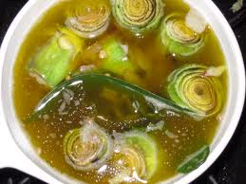
Types of Liquids that are used for poaching
Wine
Milk
Water
Bullion
A Blanc

Slide 6
Boiling
Boiling is cooking foods in liquid at boiling point
Always carried out in a pan on the top of the stove covered by a pan lid.
Many different types of foods can be cooked by boiling.
Mainly used for soups and vegetables.

Slide 7
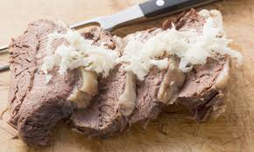
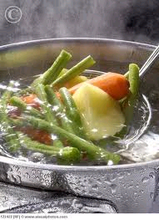
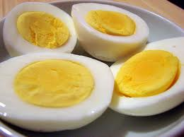
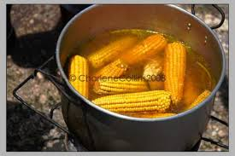
Types of food suitable for boiling
Shelled eggs
Vegetables
Soups
Sauces
Certain cuts of meat
visualphotos.com

Slide 8
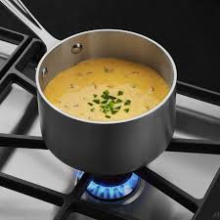
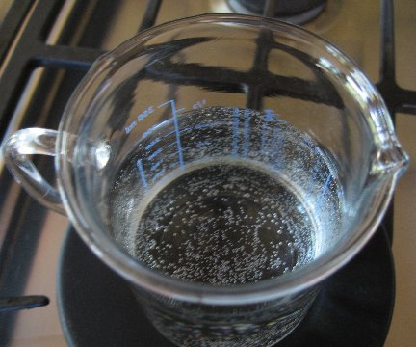
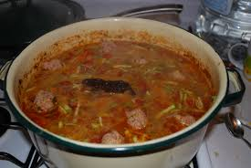
Simmering
Simmer - to cook below the boiling point, bubbles form slowly and break on the surface.

Slide 9
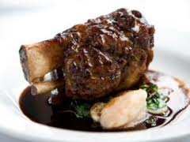
Braising/stewing
Braising and stewing are very similar
Both methods are a very long cooking process
Braising is generally carried out in the oven
Stewing is generally carried out on the stove top

Slide 10
Types of foods that are suitable for braising/stewing
Cheaper cuts of meat
Fruit
Vegetables
Chicken
Sweetbreads
Ham
Fish

Slide 11
Differences between braising and Stewing
When stewing food is normally cut into small, even sized, diced pieces
When braising food items can be left whole or in larger sizes.
Stewing normally takes place on the stove top covered in liquid
Braising normally takes place in the oven does not have to be covered in liquid

Slide 12
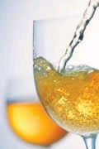
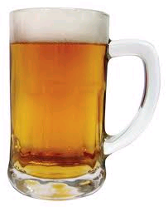
Liquids that can be used for Braising/Stewing
Stock
Beer
Wine
Water
Cider

Slide 13
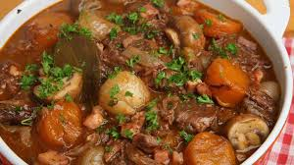
Braising / Stewing
to cook food slowly in liquid or fat for a longer period of time

Slide 14
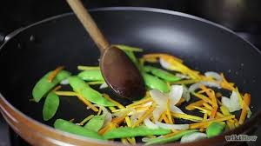
Sautéing
to fry food quickly, on a high heat, in a little hot pan

Slide 15
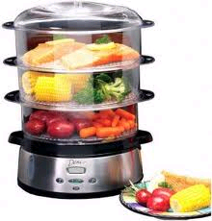
Steaming
Is fast and requires very little attention during cooking
Is cooking by the steam created by water at a high temperature

Slide 16
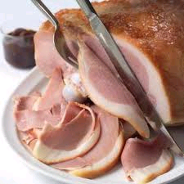
Types of dishes suitable for Steaming
Sponge based deserts
Vegetables
Chicken
Certain cuts of meat
Suet based dishes
Fish
Fruit
Hams

Slide 17
Frying shallow/deep fry
Any cooking method requiring the use of fat, such as shallow frying and deep-frying, are considered dry-heat methods. This is due to the fact that oil and water don't mix, so while fat can take a liquid form, it is the opposite of water — so it is classed as a "dry" heat method of cooking.

Slide 18
Deep frying
Cooking in deep pre-heated fat or oil
Suitable for a variety of foods
Most foods that are deep fried are coated prior to frying
The temperature of the fat is crucial when deep frying it must be between 170 to 190 degree C if it is too cold the food will soak up the fat if it is too hot and it will make the food taste burnt and will not cook the food through to the middle

Slide 19
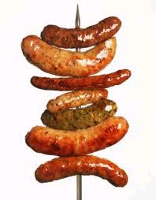
Types of food suitable for deep frying
Chicken
Potatoes
Fish
Certain fruits
Sausages
Dough to make doughnuts

Slide 20
Coating deep fried or shallow fried foods
Delicate foods should always be coated prior to frying to avoid them breaking up during cooking
Batter can be used to deep fry fish, prawns etc
Bread crumbs is often used to coat chicken, fish or other similar foods
Seasoned flour is also used to coat foods prior to frying

Slide 21
Shallow fry
Shallow frying is cooking in a pan with a small amount of fat, oil or butter.
Gives food a pleasant colour and flavour
Makes food palatable and safe to eat
If butter is to be used it must be clarified first to avoid it burning.
The fat or oil must be pre-heated prior to frying

Slide 22
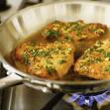
Foods suitable for shallow frying
Thin cuts of tender meat such as steak
Eggs
Sausage, bacon, chops etc
Potatoes
Fish
Pancakes
Onions

Slide 23
Stir frying
Stir frying is a rapid cooking method first introduced in China to cut down on fuel costs.
It is a very healthy method of cooking
Seals in flavours
A small amount of oil is used to stir fry foods
Vegetables should all be cut into uniform sizes so that the cook properly.

Slide 24
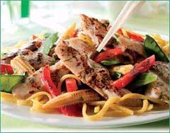
Foods suitable for stir frying
Chicken
Tender cuts of meat
Vegetables
Noodles

Slide 25
Roasting
Roasting is the slow cooking of meat, fish and vegetable, uncovered, with dry heat.
Roasting is suitable for large cuts of meat such as whole chickens or joints of meat
Spit roasting is an alternative method to the oven

Slide 26
Roasting
When roasting meat you should always protect it by covering with oil or a layer of tin foil to stop moisture loss and the meat becoming dry
When roasting the meat should be placed on a rack, or a roasting pan to ensure even application of heat.
During roasting hot air circulates around the meat, cooking all sides evenly,

Slide 27
Dry Methods of Cooking
Baking
Microwaving
Grilling
Barbeque

Slide 28
Baking
Baking is a dry heat method of cooking usually carried out in an oven
It is primarily used for bread, cakes, pies, pizza and other goods that are classed as bakery products.
Baking does not require any fat but can sometimes require a little bit of steam depending on the product that you are baking and the end result that you require.

Slide 29
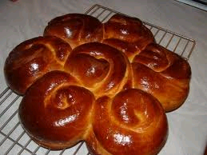
Baking
Baking makes food palatable and digestible.
Gives food a good golden brown colour which is achieved by the caramelization of sugars that are naturally found in flour.
the oven temperature depends on the product that you are baking.

Slide 30
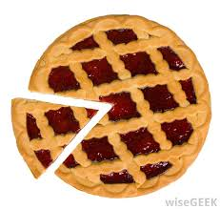
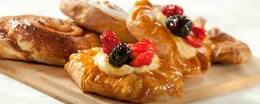
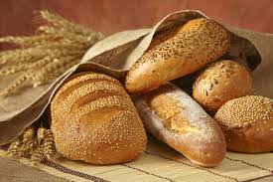
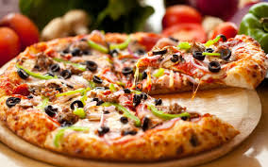
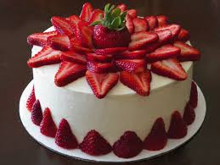
Foods Suitable for baking
Bread
Pastry
Pizza
Pies
Egg based products
Cakes

Slide 31
Grilling and broiling
Grilling is the quick cooking of meat and other food products
Will create very distinctive textures and flavours
Will produce simple uncomplicated dishes
Ideal for fish, tender cuts of meat and poultry
Grilling is when the food is cooked with heat underneath Broiling is when the heat is from above
Both will have the same results and all food will need to be turned during cooking

Slide 32
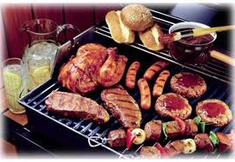
Foods Suitable for grilling
Fish
Vegetables
Bacon, sausage etc
Steaks
Fruit
Chicken
bread

Slide 33
Barbeque
Very similar to grilling
Food is cooked on a grill over coals
Food is generally cooked outdoor
Gives a unique charcoal grilled flavour
Suitable for small cuts of meat
Versatile
Fruit and vegetables are cooked quickly

Slide 34
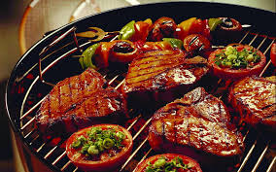
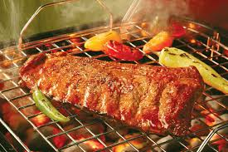
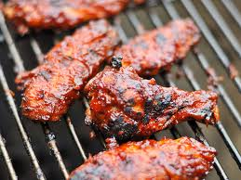
Barbeque
Very similar to grilling
The meat is covered with a souce or marinde
Food is cooked on a grill over coals
Suitable for small cuts of meat
Fruit and vegetables are cooked quickly

Slide 35
Cooking methods that can be applied to desserts

Slide 36
The cooking of food in oil or another fat.
FRYING
Baking is a method of preparing food that uses dry heat, normally in an oven
BAKING
COOKING
Alcohol is added to a hot pan to create a burst of flames.
FLAMBEING
NO HEAT
Preparing desserts that require no heat. (mousses, ice cream,..)

