Slide 1
Description of Dishes
Mihaela Lazovic, PhD

Slide 2
Description of dishes
Main ingredients (underline)
Method of cooking (bold)
Method od serving (italic)
Homemade leek and potato soup
Hot and tasty combination of fresh leeks and potato seasoned with fresh herbs

Slide 3
The name of the dish may indicate the method of cooking
Boiled carrot
Fried fish
Baked potatoes
Smoked beef Breaded cheese
Poached trout

Slide 4
PAST PARTICIPLE
The method of cooking is expressed by the PAST PARTICIPLE of the verb. It is formed by adding the ending -ed to regular verbs or III column for irregular verbs
Bake + ed – BAKED
Grind – GORUND
Freeze – FROZEN
Cut – CUT

Slide 5
Methods of Cooking
to bake — baked
to boil — boiled
to braise — braised
to chop — chopped
to cook — cooked
to flambé — flambéed
to fry — fried
to grate — grated
to grill — grilled
to mash — mashed
to melt — melted

Slide 6
Methods of Cooking
to mince — minced
to poach — poached to roast — roasted
to sauté — sautéed
to season — seasoned
to scramble — scrambled
to smoke — smoked
to slice — sliced
to sprinkle — sprinkled
to steam — steamed
to stew — stewed
to stuff — stuffed
to whip — whipped

Slide 7
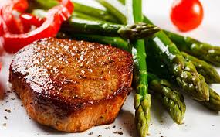
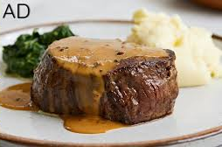
Creamed fillet of beef with peppers
Thin slices of beef filet, cooked in cream with paprika and thinly sliced red peppers garnished with grilled vegetables

Slide 8
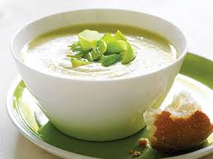
Homemade leek and potato soup
Hot and tasty combination of fresh leeks and potato seasoned with fresh herbs
Creamed fillet of beef with peppers
Thin slices of beef filet, cooked in cream with paprika and thinly sliced red peppers garnished with grilled vegetables

Slide 11
Gibanica
Slices of filo pastry stuffed with a mixure of eggs and cheese and baked in the oven. Served with yogurt.

Slide 12
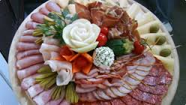
Meze
A selection of cured meats (ham, bacon, sausage), homemade cheese served on a plater, garnished with tomatoes and olives

Slide 13
Prebranac
Boiled white beans and braised onions seasoned with pepper and hot paprika and baked

Slide 14
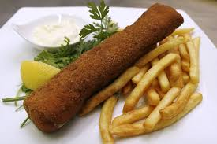
Esckalope Karadjordje
Rolled slices of veal stuffed with kajmak and breaded. Served with French fries and tartar sauce.

Slide 15
Sarma
Braised minced meat and rice rolled into sour cabbage leaves, stewed on moderate heat. Served hot with sour cream

Slide 16
Bosnian caserolle
Mutton and beef cut into cubes and stewed with various vegetables, baked in the oven.

Slide 17
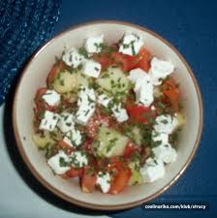
Sopska salad
Onions, tomatoes and cucumbers dressed with oil and vinegar and sprinkled with grated or crumbled cheese

Slide 18
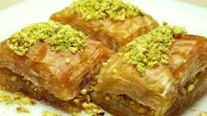
Baklava
Slices of filo pastry stuffed with ground walnuts, baked in the oven and topped with a sugar and lemon syrup.

Slide 19
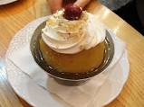
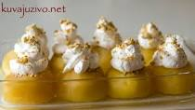
Tufahije
Poached apples stuffed with a mixture of walnuts and almonds and baked in the oven, served with whipped cream

