Slide 1
Parts of Meals: Courses

Slide 2
vocabulary
A course
is a part or stage of a meal often served formally and often described according to the main food provided.
Fish course
Meat course
3-course meal, 5-course meal;
first / second / main course

Slide 3
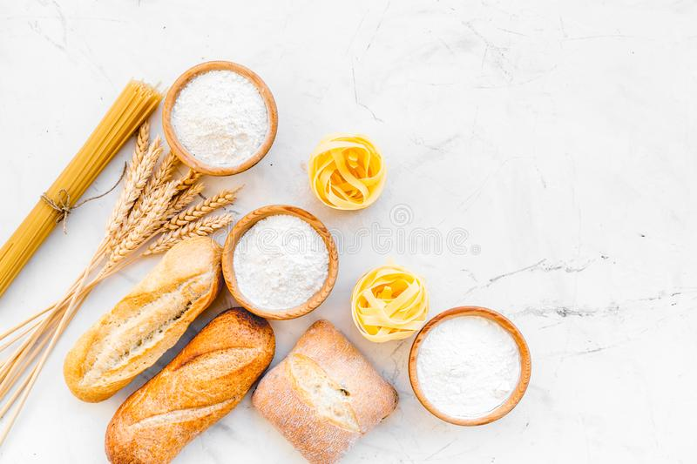
names of the courses:
hors d’oeuvre - several types of tasty food offered in small quantities at the beginning of a meal.
appetizer (starter) - a small serving of juice, fruit, seafood, etc. at the beginning of the meal to make people want to eat.
soup - usually the first course in a formal dinner (or meal).
farinaceous - dish prepared from flour (such as macaroni, spaghetti, etc.) or cereals (rice, corn, etc.), and served with melted butter, cheese and various sauces.

Slide 4
eggs - garnished egg dishes.
fish - the fish course in a formal meal, usually served after the soup and before the entrée . Nearly all kinds of fish can be served but without complicated garnishes.
entrée - (US) the main dish of a meal; (UK) at very formal meals, a small dish served just before the main part.
This is a dish of meat, game or poultry which is not roasted or grilled. Vegetables are not served with an entrée if it is followed by roasts with vegetables. Entrée dishes are usually light, small and garnished.

Slide 5
main (meat) course - roasts and grills usually served with vegetables and / or a salad.
sweet - sweet food served after the main course in a meal.
savoury - something pleasant to eat, a delicacy, but with a salty taste; the last course in a formal meal.
cheese and biscuits - a selection of cheeses and biscuits, esp. served at the end of a formal dinner.
dessert - fresh fruit of all kinds and nuts.
coffee - the last stage of most present-day European and American dinner parties, where coffee is taken either at the table or in the living-room.

Slide 6
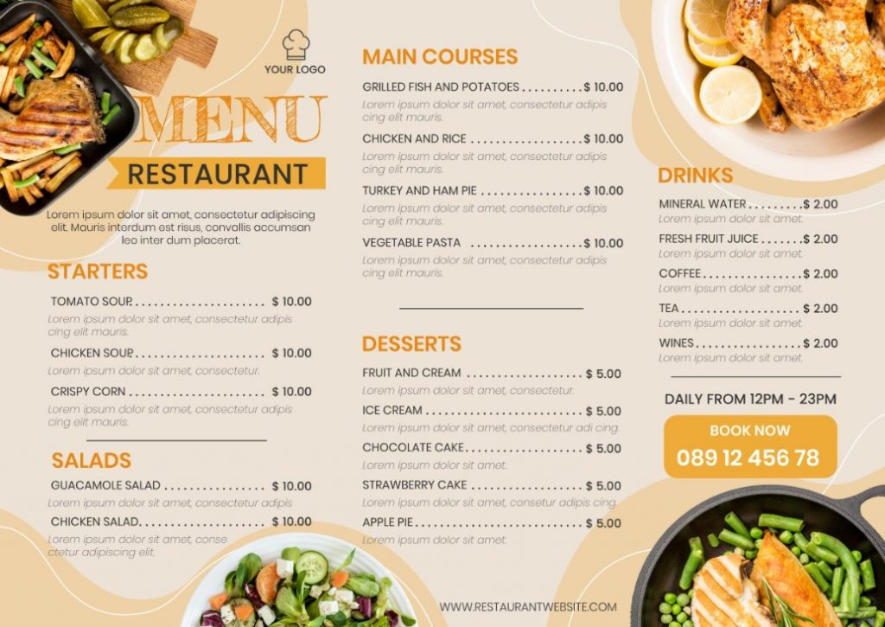

Slide 7
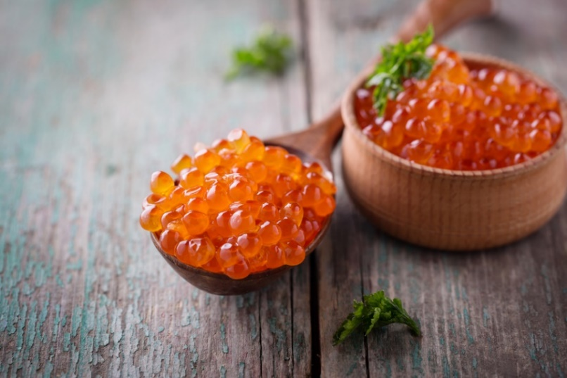
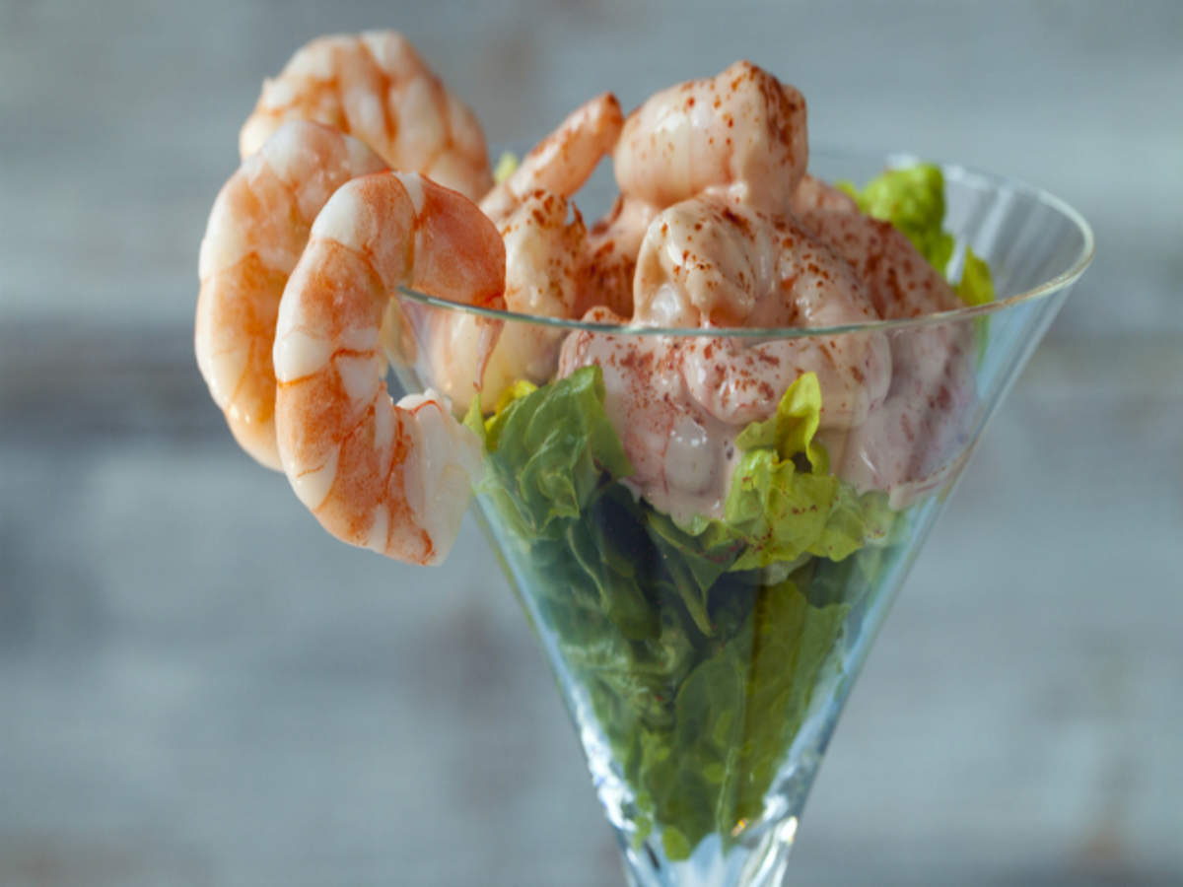
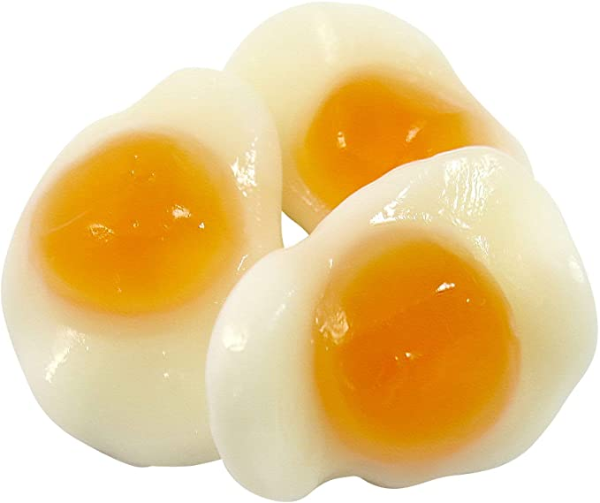
hors d’oeuvre/ /ˌɔː ˈdɜːv/ /starter/appetizer
cold:
fish/seafood (smoked/marinated)
stuffed eggs/jellied eggs
Vegetables a la grecque (cooked in a marinade, flavoured with olive oil and lemon, served cold)
Cured meat/ cold cuts (ham, sausages…)
Fish roes
Stuffed grapefruit
Prawn cocktail …

Slide 8
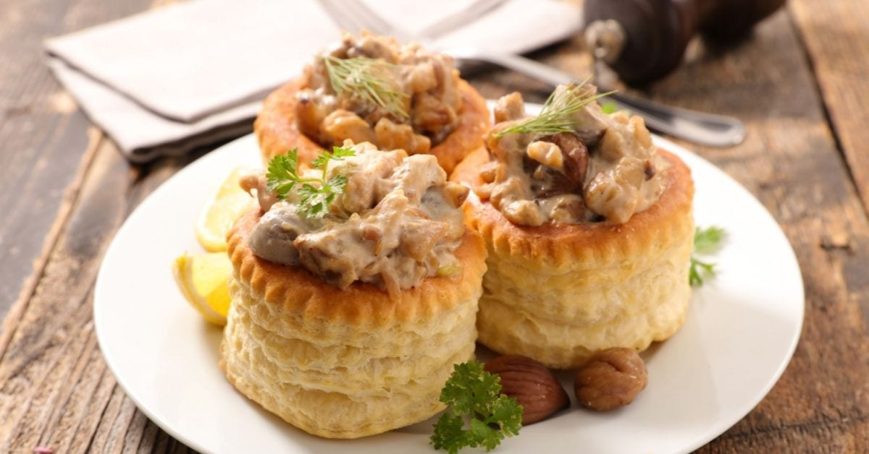
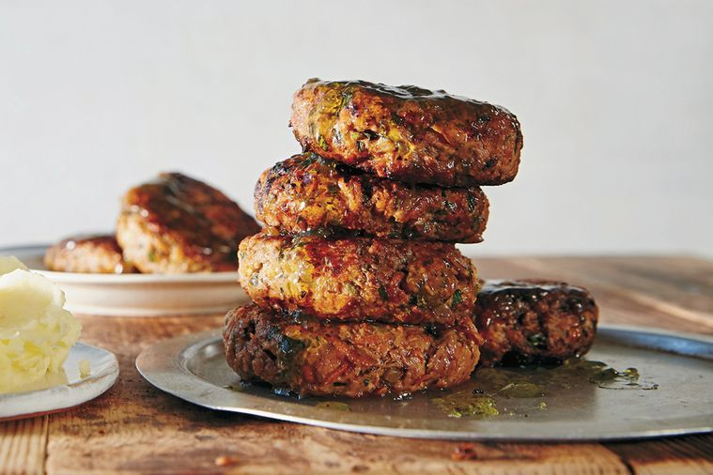
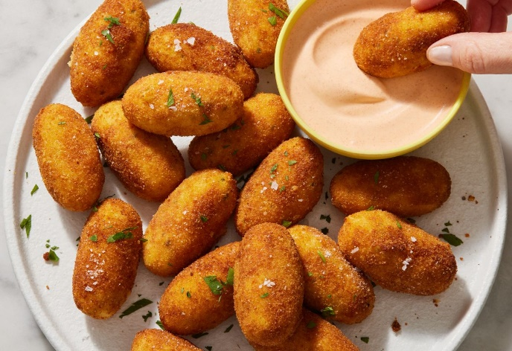
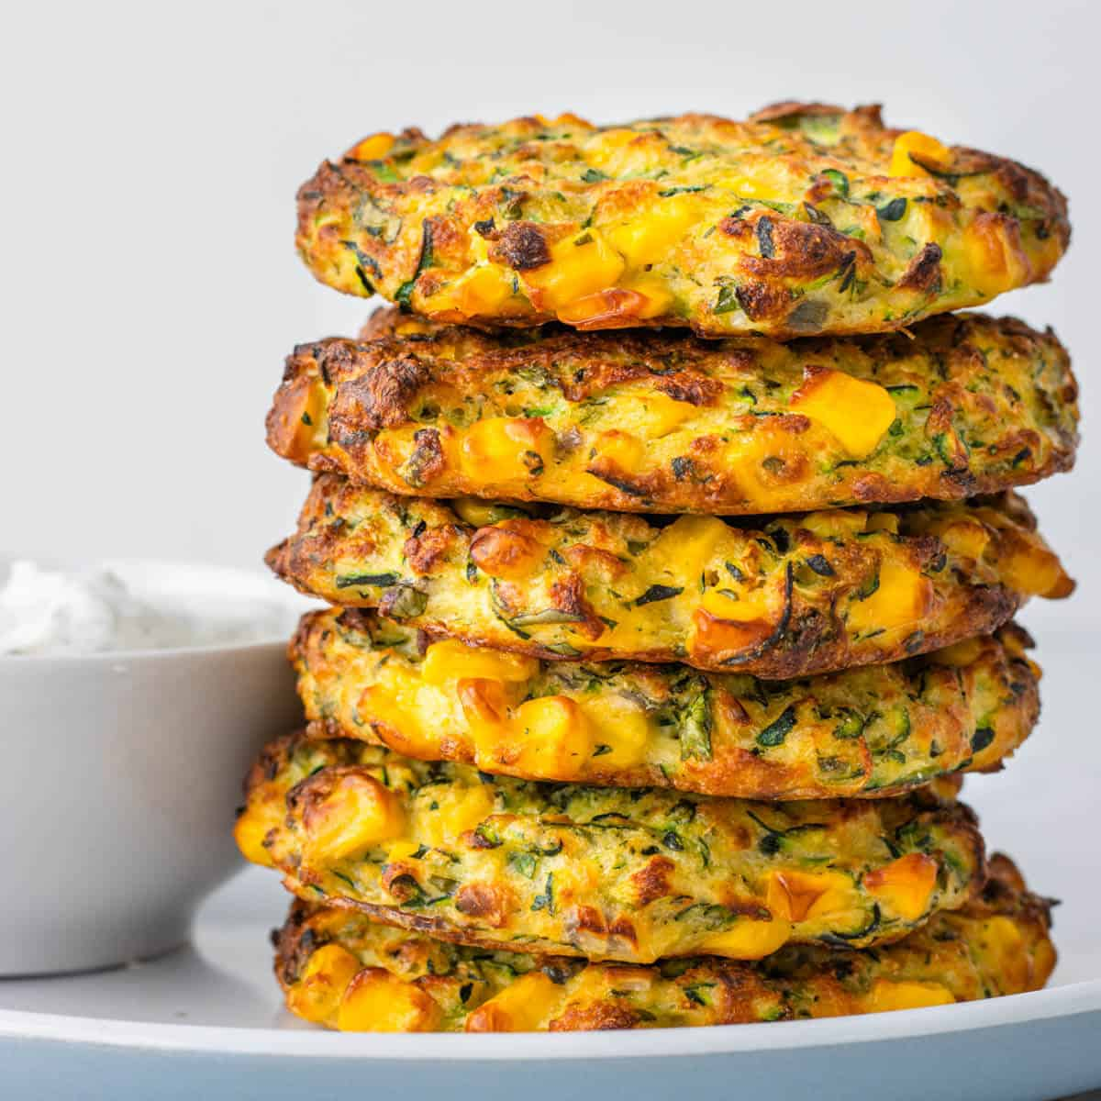
Hors d’oeuvre/ /starter/appetizer hot: vols-au-vent croquettes rissoles fritters
vol-au-vent rissole
a small, light, cup-shaped pastry minced cooked meat or case with a savoury sauce filling fish coated in egg and
breadcrumbs and fried in deep fat
croquette
a small roll of mashed potatoes or some fritter
other vegetable, minced meat or fish, any kind of food coated
coated with breadcrumbs and deep-fried in batter and deep-fried

Slide 9
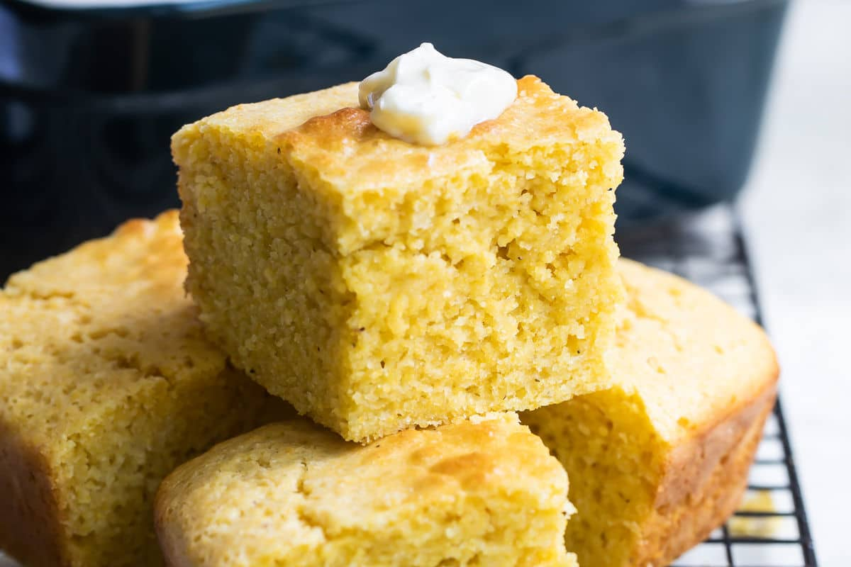
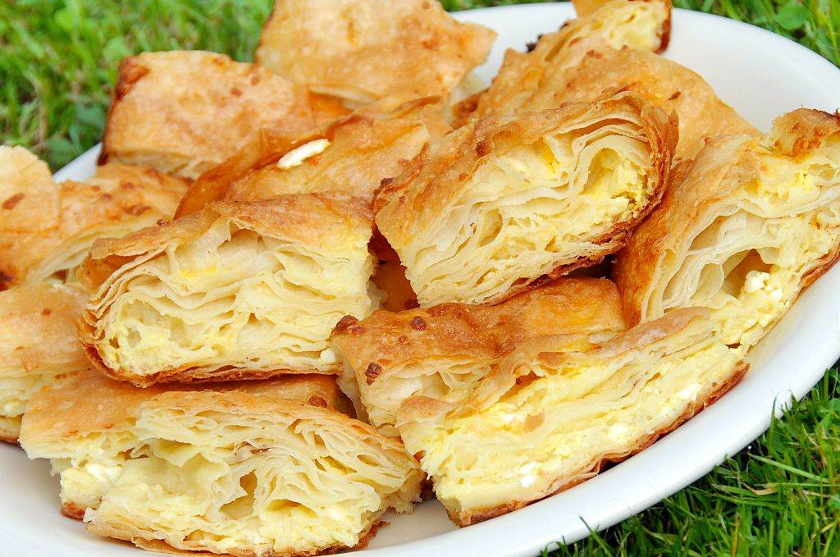
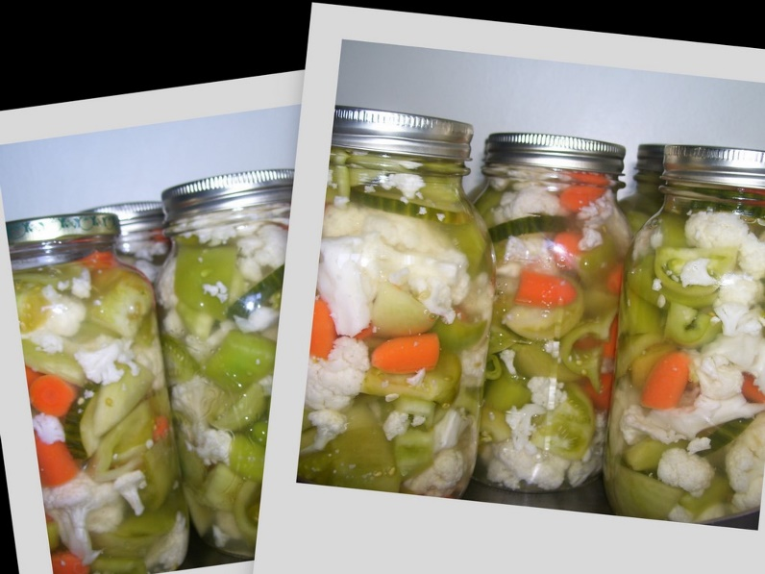
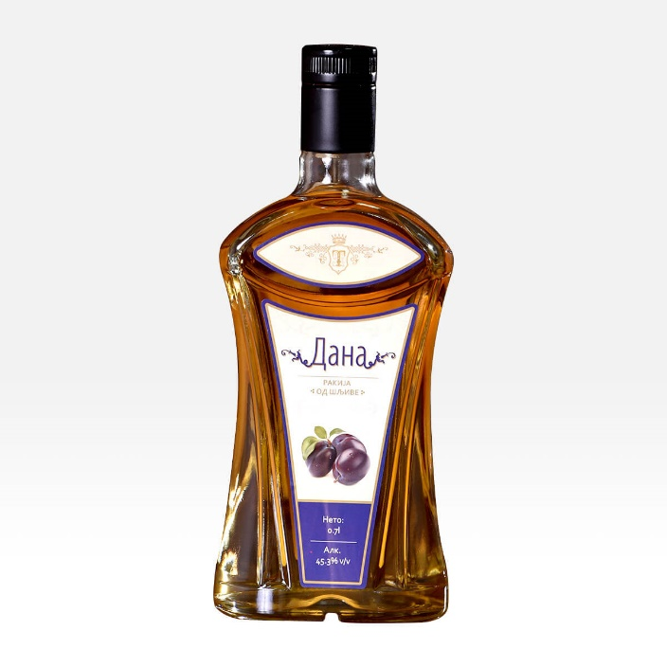
Appetizers of the Balkan Cuisine - Identify the dishes
Cornbread
Gibanitza
Turshiya
Plum brandy (shljivovitza)

Slide 10
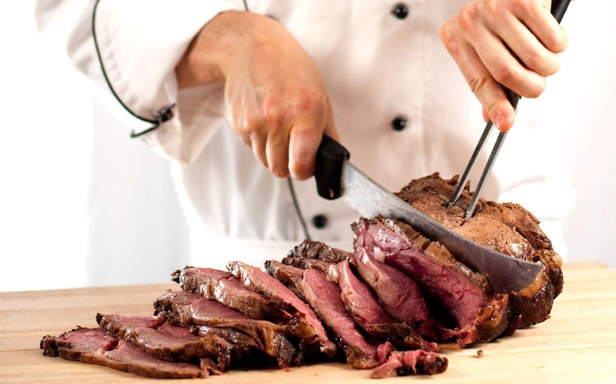
Entrée
stews (ragout) pilaff, moussaka, goulash, hamburgers, kebab, pies, casseroles, fried or grilled fillet steaks, etc.
meat, game, poultry or offal, pasta and vegetables
carved and portioned.
luncheon (=lunch) menus.

Slide 11
methods of cooking applied to the cuts or portions of meat:
stewing,
sautéing
frying,
baking,
roasting
grilling

Slide 12
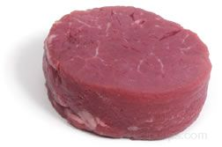
tournedo - (meat cut) , small round pieces of beef cut from the end portion of beef tenderloin

Slide 13
Answer the questions
What English terms are used for the French “hors d’oeuvre"?
What are the main ways of serving hors d’oeuvre?
What is the aim of the hors d’oeuvre?
What are the main requirements for hors d’oeuvre dishes?
What kinds of food and dishes may be served as an hors d’oeuvre?
What foods may be served as a starter in Serbia?
What food does mezze include?
What place in the meal does the entrée occupy now?
What are the specific features of entrée dishes?
What are the most popular entrée dishes?

Slide 14
Dish is food that is prepared in a particular style or combination.
Portion is a quantity of food for one person as served in a restaurant.
Helping is the amount of food that you get at a single serving.
Seconds (informal) is second serving of food at a meal.

Slide 15
Dish/portion/helping/seconds p.174 ex.1
Baked apples are his favourite….
I gave him a second… of pudding
He was hungry and ordered two…. Of fish
I’d like the second…of meat, please.
He quickly ate everything on his plate and asked for….
The…. are generous in this restaurant.
Fresh berry tarts were so good that everyone took….

Slide 16
p. 175 ex 2. In the texts find different methods of cooking various kinds of food and complete the following sentences.
Fish and seafood can be marinated….
Meat can be smoked….
Vegetables can be boiled,….
Eggs can be boiled,….

Slide 17
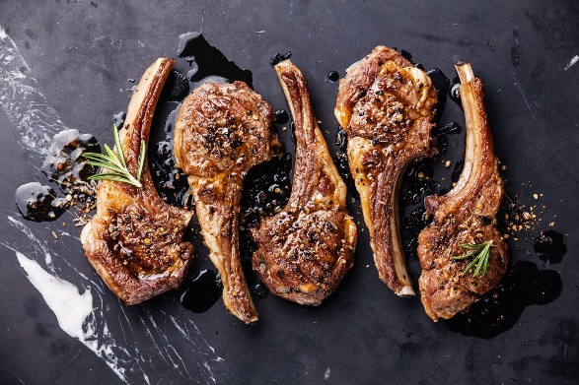
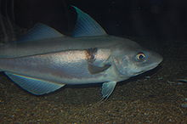
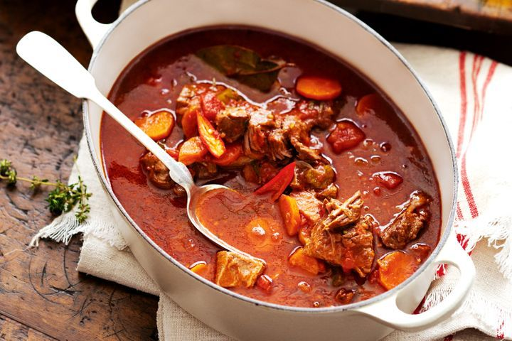
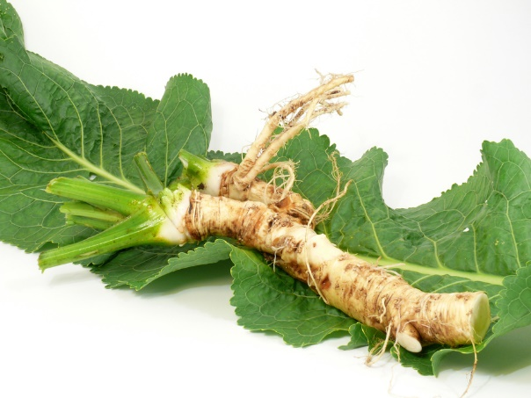
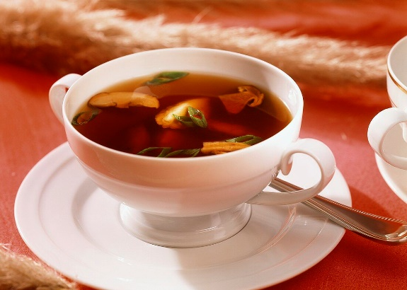
1. hors d’oeuvre 2. Soup 3. Fish course 4. Main course
Boiled salmon, Cold eggs mayonnaise, Bouillon with dumplings, Braised leg of mutton, Ox tongue with horseradish, Noodle soup with chicken, Fillet of beef Wellington, Escalope(=thin meat) Karadjordje style, Cream of green pea soup,, Lamb cutlet, Haddock with butter, Smoked ham, Caviar canapé, Stuffed trout, Beef ragout soup, Mixed pickles, Grilled sterlet, Pork leg jelly, Goulash, Trout in aspic= gelatin, Fried pilchard=sardines, Sole English style, Breaded cheese, English roast beef, Roast suckling pig (prasetina), Tomato salad

Slide 18
moussaka / casserole / goulash / pilaf / kebab / fritter / croquette / vol-au-vent P. 176 ex 5
…a small, light, cup-shaped pastry case with a savoury filling
…. a small rounded mass of food, such as meat, fish or potato, that has been cut into small pieces, pressed together, covered in breadcrumbs and fried
…a slice of fruit, vegetable or meat covered with batter (= a mixture of flour, egg and milk) and then fried
…. a dish, originally from Greece, consisting of meat tomato and aubergine, with cheese on top, cooked in the oven
…. rice cooked in spicy liquid, often with vegetables or meat added
…a dish consisting of small pieces of meat and vegetables that have been put on a long thin stick or metal rod and cooked usually in dry heat
…. a savoury dish, originally from Hungary, which consists of meat cooked in a sauce with paprika
…. a dish made by cooking meat, vegetables or other foods in liquid in a covered dish at low heat, often in the oven

Slide 19
Divide the following adjectives into the groups given below.
attractive, sweet, delicious, sour, delicate, colourful, appetizing, soft, bitter, tender, fresh, tough, smooth, pleasant, creamy, light, hot, spicy, piquant, tart, salty, savoury, sharp, heavy
Flavour of food
Appearance of food
Texture of food
Hard to digest

Slide 20
accompaniment / occasion / pickles / cookery / functions / delicacy / doily / aperitif p. 177 ex 9
A dry champagne makes the ideal…. for(to) this dish.
Would you like an… before dinner
In the centre of the table on a silver dish covered …. with a there was a beautifully-decorated cake.
In some parts of the world, certain foods, such as frog’s legs, snails, or sheep’s eyes are considered a great….
As it was such a special ….. she permitted herself a small glass of champagne.
Have some…. with your salad.
There are quite a number of great names in the history of….
I see her two or three times a year, usually at social….

Slide 21
In the text that follows the words menu (2), food (5), meal (2), course (3), dinner (1), dish (2), seconds (1) are left out. Fill in the gaps with these words. p. 178
I enjoy planning…… for my friends, preparing the…… and serving them myself. Often, I am sharing not just…. But a whole new vegetarian way of eating. Let me tell you this very short story. Among the guests of a dinner party there was a couple that I had not met before, and whom I sincerely wanted to please. As we were sitting down to …., the man announced in loud though not unpleasant tones: “I just want you to know that I cant stand vegetarian…… “I smiled and served the firs….. Pea soup with butter dumplings. “But I love good soup!” he declared. So, it went, right on to the fresh berry tarts, of which everyone present took…… the point is that very few people dislike good….. And if you give them good….., they wont even notice that they haven’t consumed their usual ration of meat. My personal experience is that serving a…. That is somewhat foreign to the guests usually makes a dinner party a success. The guests are not only well-fed, they are also intrigued and flattered. Planning a good…… is fine-pointed skill, particularly in the vegetarian cuisine. Each….. Has an architecture! One or several….. May be central. When I serve a variety of…… at a supper, I always try to arrange them in….. Each separate… is so much more appreciated when it enjoys unshared attention.

Slide 22
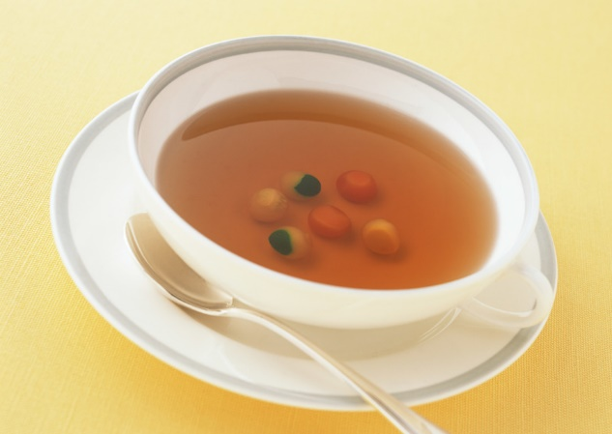
soups
stock - made by boiling vegetables or the bones used to add flavor to soups and other food
consommé -a thin, clear soup
broth - a thin soup, often with vegetables or rice in it
cream soup/potage
bouillon- a thin, clear soup made by boiling meat and vegetables in water

Slide 23
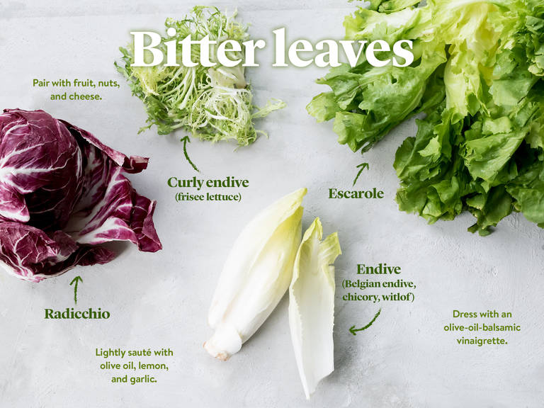
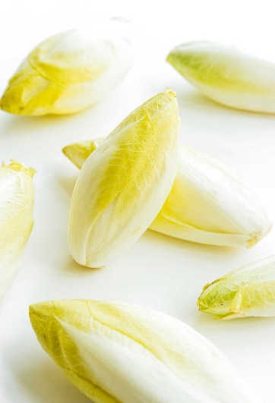
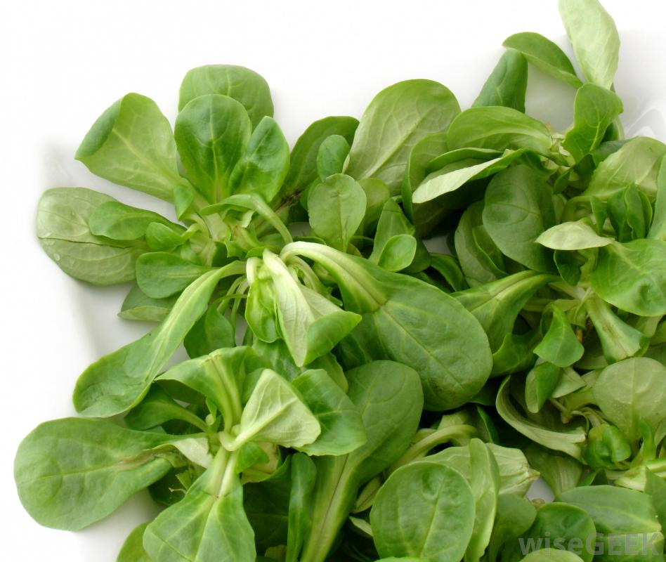
salads
green + dressing
lettuce
Rocket (arugula)
Endive
Chicory
lamb’s lettuce
plain
vegetables (raw/cooked)
compound
vegetables (fruit)
pasta, rice
fish, meat

Slide 24
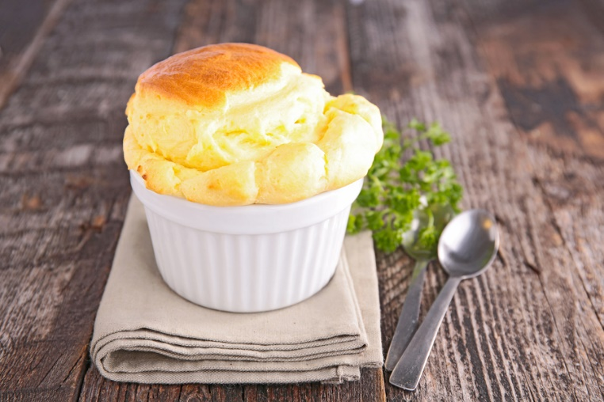
desserts
pies, tarts, cakes,
gateaux (gateau) - a large, sweet cake, usually with cream or fruit in it
pancakes, donuts
mousse, souffle
pudding
fruit salad, preserves, compote
ice cream, sorbet, parfait

Slide 25
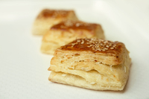
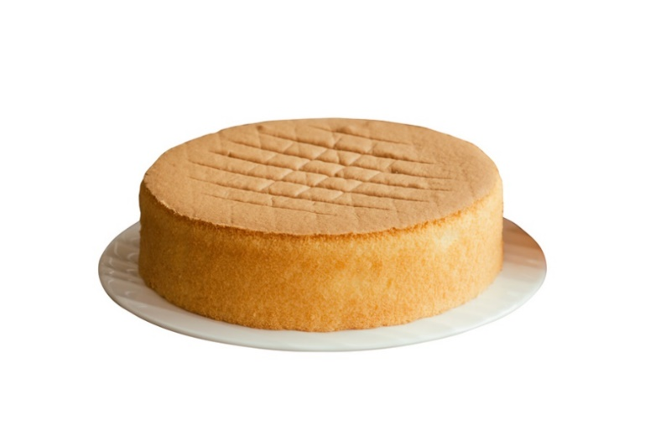
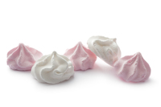
puff pastry
choux pastry
sponge
meringue
glazing/coating/icing

Slide 26
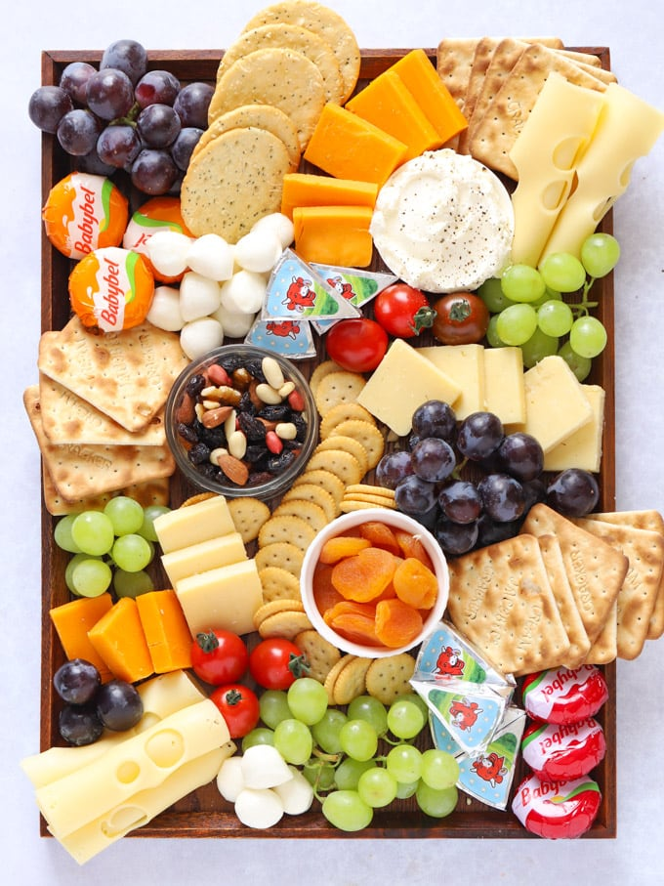
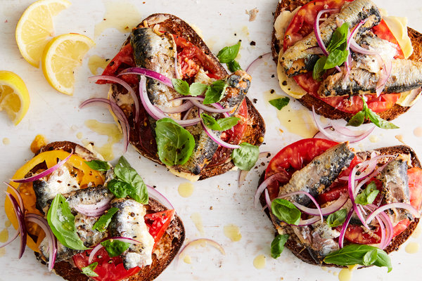
Savouries (after or instead of sweet dish)
cheese platter
mushroom/sardines on toast

