Slide 1
Styles of table service

Slide 2
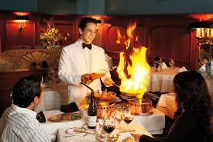
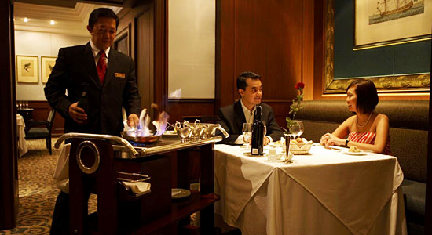
French service
Found in luxury restaurants with a la carte menu
The dishes are brought from the kitchen on a trolley and they are served from the trolley in the dining room.
The dish is first presented to the guests
The dish is carved, filleted and portioned, and served to the guests

Slide 3
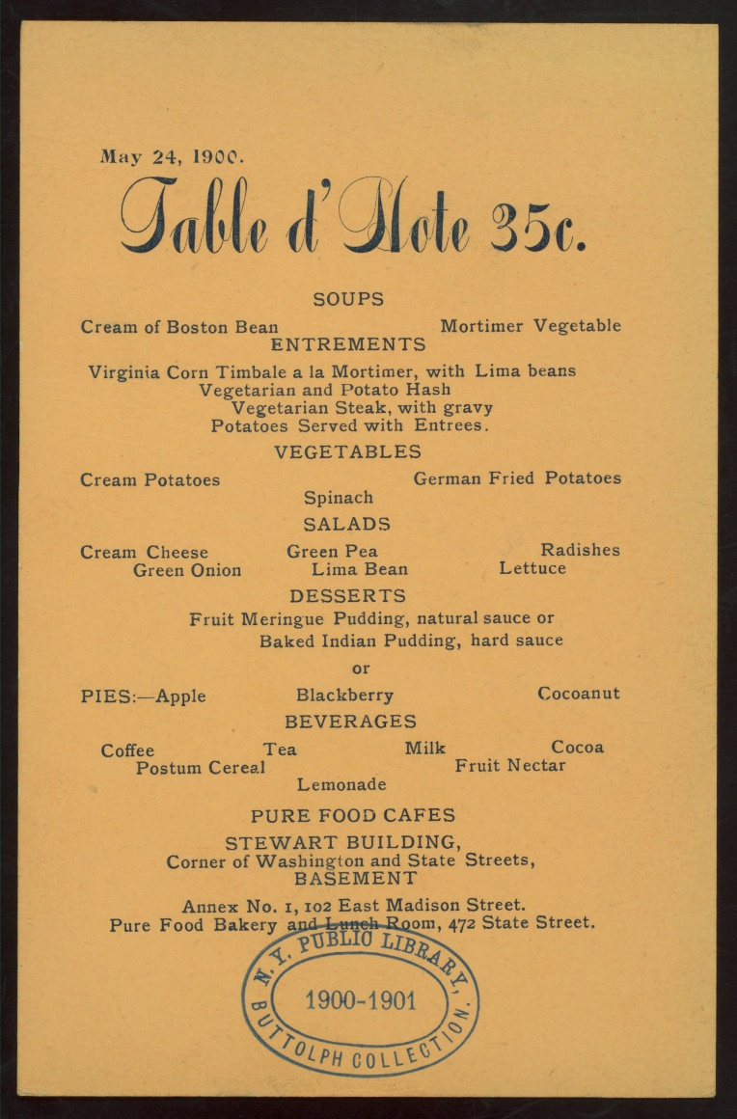
A La Carte vs. Table d’hote /ˌtɑː.blə ˈdəʊt/ menu
the à la Carte is a menu type having a wide variety of courses that are individually priced
whereas the table d’hôte is a menu type usually with a set number of courses, all for a set price.

Slide 4
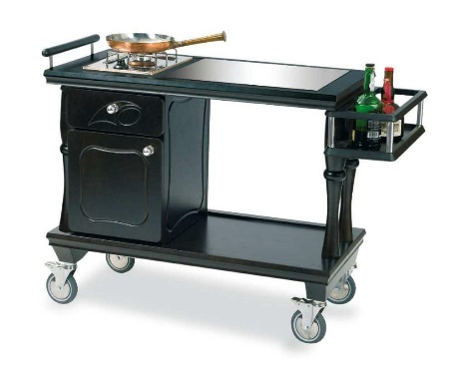
gueridon
A gueridon is a small table on wheels, sometimes with an upper and lower shelf, that is well equipped to prepare and cook the food in front of the guest. There will be a working area, a gas hob, chopping board, cutlery drawer, cold store, etc.

Slide 5
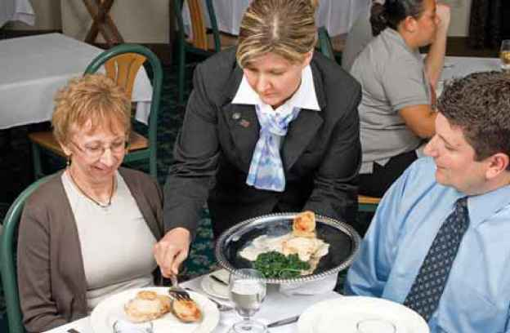
Russian service
Less complicated
A la carte or table d’hôte menu
In the kitchen various foods are carved, filleted and arranged directly on silver dishes (so-called platters), and then taken into the dining room, where they are presented to guests.

Slide 6
Supreme – the best piece of meat (usually of chicken or fish)
Salmon supreme Salmon steak

Slide 7
American Service
table d’hôte /ˌtɑː.blə ˈdəʊt/ menu menu
The food is placed on plates in the kitchen. The waiter only has to place it in front of the guest and make sure that the correct cover is laid and that all the necessary accompaniments are on the table.

Slide 8
American service has many advantages.
Firstly, it is faster. That is why plate service is offered in restaurants with rapid turnover, where speedy service is necessary.
Secondly, it demands less equipment for the service of the meal and consequently less washing-up.

Slide 9
buffet style service / self-service
all of the food is avail-able, at the correct temperature, in a separate serving space (counters/tables)
Guests help themselves to the food

Slide 10
Comprehension check
What are the main types of table service?
On what factors does the choice of a table service depend?
How does Russian service differ from French service?
What skills does a waiter require for gueridon service?
Why is plate service labour-saving?
What kinds of service are used with a table d’hôte menu?
What is the difference between silver service and plate service?
Why is buffet style service often used in hotel restaurants?

Slide 11
platter / counter / cutlery / tray / supreme / counter / turnover / saddle / cover / steak
1. If you order a…..for me, then I would like to have it well-done, not rare
2. One of his duties in the restaurant was to polish…..: knives, spoons…
3. They had a traditional dish of roast….. of lamb with salad for dinner.
4. The waiter was carrying a …. of drinks
5. You will find sausages on the meat…… and rolls on the bread….
6. Large supermarkets have high….: their goods sell very quickly
7. Breast of chicken, when it is removed raw from one side of the bird in a skinless, boneless piece is called a ….. The term is also used for a fine fillet of fish.
8. There was a large oval….in the centre of the table with a colourful assortment of vegetables on it: cucumbers, tomatoes, lettuce, red and yellow peppers.
9. Plates, glasses and cutlery for each diner, also known as…..are usually arranged on the table according to certain rules.

Slide 12
Write one word for the following description:
….. to pour alcohol over food and set fire to it during cooking
….. to make a surface shiny by putting a liquid substance onto it and leaving it or heating it until it dries.
…..to cut thin pieces from a large piece of cooked meat
…..to decorate food with a small amount of different food
…..to put sth in a particular order

Slide 13
Use the verbs to complete the following sentences.
….the dish with parsley before serving.
Would you like me to….the chicken?
….the pastry with beaten egg.
If you want to….pancakes, you need some strong brandy.
Cut fresh raw vegetables onto sticks and….the vegetables in bunches on a platter. Serve with garlic mayonnaise.

Slide 14
In the text find one word for each description
a small table on very small wheels from which food and drinks are served.
a place for one person set at a table with a knife, fork, plate, glass and napkin.
knives, forks, spoons used at table when eating, especially made of stain-less steel.
a thing or event that is usually found with something else.
a large flat dish used for serving food especially meat.
a special dish of a particular restaurant that is always very good.

Slide 15
Fill in the gaps with the words from the previous exercise.
1.Fish baked in pastry is the….of this restaurant
2.This sauce is often served as an….to fish
3.There were five kinds of cheese on a wooden….
4. Chocolate gateau was a…..of the Café de Rome
5. Arthur opened the doors of his suite. The floor waiter was there with a full …..of pots under covers from which escaped an appetizing aroma
6.Mary was afraid of making a mistake with her….so she watched closely how other peope at the table used their knives and forks.

Slide 16
The passive voice

