Slide 1
Organizing People and Jobs in the Restaurant
Unit 1

Slide 2
Jobs in a restaurant

Slide 3
waiter/waitress
takes food orders
serves food
must be able to explain items on the menu, or recommend dishes.

Slide 4
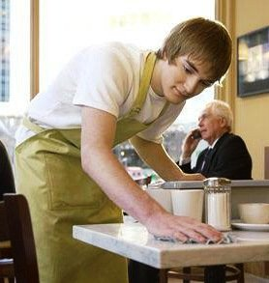
busboys and busgirls (bussers)
clean tables or bring bread and water to the tables.

Slide 5
host/ hostess
welcomes and seats guests when they arrive
arranges reservations in restaurants
takes drink orders from the guests after they have been seated.

Slide 6
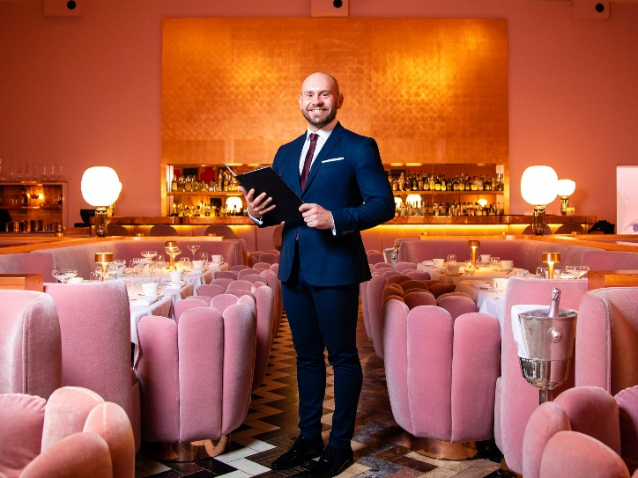
maitre d’ (short for matre d’hotel).
supervises employees and operations
is dealing with any customer complaints.

Slide 7
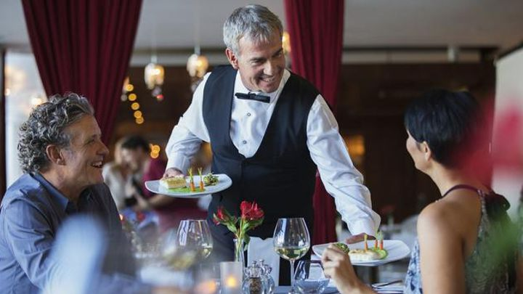
headwaiter
is second in command
supervises service in a particular area of a restaurant,
In smaller restaurants carries out the tasks of the maitre d'hotel
usually thanks the guests when they leave

Slide 8
captain = the chef de rang
is usually responsible for running one area of the restaurant and supervising the work of two or three staff members
is responsible for the communication between the kitchen and the front-of-house
allocates tasks and monitors service.

Slide 9
food and beverage manager
is responsible for the overall running of a restaurant:
planning the menu with the chef de cuisine;
creating the right atmosphere and ambiance;
hiring staff;
managing bookings;
meeting and greeting customers.

Slide 10
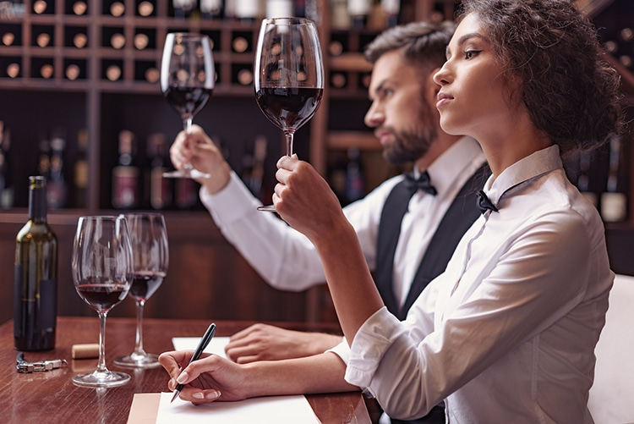
wine waiter/steward or sommelier,
usually only present in more formal restaurants
is responsible for choosing wines, recommending and serving them to customers.

Slide 11
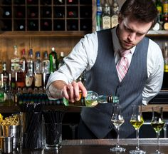
bartender
prepares drinks for customers during their meal, giving them to the waiters to take to the tables.
When there is no sommelier, the bartender may be responsible for a restaurant's wine stock.

Slide 12
cashier
deals with payments

Slide 13
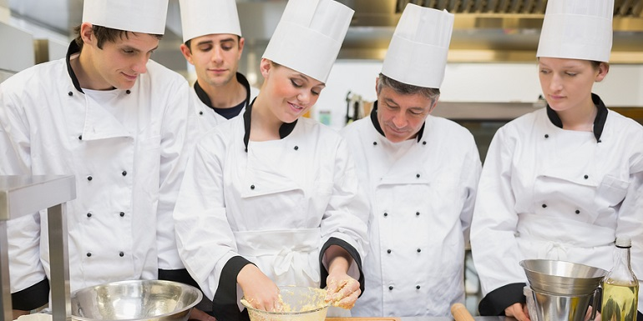
Jobs in the kitchen

Slide 14
chef de cuisine, or head chef
manages the kitchen, gives directions on dish preparation, takes decisions about portions and service to the public and does the most difficult processes
plans menus and buys raw materials
is responsible for materials/equipment/hygiene etc.
supervises communication of orders and deliveries to the kitchen and restaurant and reports to the food and beverage manager.

Slide 15
sous chefs
are usually part of larger kitchens.
they support the chef de cuisine and substitute him/her when absent

Slide 16
chef de partie
substitutes the sous chef in smaller restaurants.
he/she is usually responsible for one department.

Slide 17
commis chefs
work at an operational level.
They usually take care of meal preparation, organise basic ingredients and carry out simple activities during the preparation of dishes.
They assist

Slide 18
kitchen helper/ dishwasher
assists in the kitchen/ washes the dishes

Slide 19
Read the text on p. 149. What are the main responsibilities of the employees in a restaurant?

Slide 20
useful vocabulary
Bussers’ tasks:
to pour water
to remove extra covers
to serve bread and butter
to clear tables
Waiters’ tasks:
to take orders
to bring food/drinks to the guest
to replace ashtrays

Slide 21
to pour to remove to serve to clear to take to bring to replace
_______ me that knife, please
I spilled the juice while I was____________it.
Do they ______ meals in the bar?
I ___________orders from you! You are not my boss!
This detergent will ________ even old stains.
The factory ________ most of its workers with robots.
Bring/ pouring/serve/ don’t take /remove/replaced

Slide 22
T or F

Slide 23
Promote/purchase/deposit/store/audit/supervise/scedule
to make an official examination of the accounts of a business and produce report
to buy
to put or keep things in a special place for use in the future
to encourage people to like, buy, use, do, or support sth
to watch a person or activity to make certain that everything is done correctly, safely
(often passive) to arrange that an event or activity will happen at a particular time
to put sth valuable, specially money, in a bank or safe

Slide 24
1. advertising companies are always having to think up new ways……to products
2.the data is……on a hard disk and backed up on a CD.
3.I ….. $500 in my account this morning.
4. The UN is…… the distribution of aid by local agencies in the disaster area.
5.The meeting of the staff has been…...for tomorrow afternoon.
7.When we……..work shifts in our restaurant, we considered workload and staff requirements
8. Bookkeepers may compute daily cash intake,……money in bank,……guests’ checks and maintain financial records

Slide 25
Busperson/pantry supervisor/kitchen helper/bookkeeper/purchasing agent and storeroom supervisor/cashier/host/captain
Audits guests’ checks, compute daily cash intake, deposit money, maintain financial records….
Orders, receives, inspects, and stores all food for distribution to the different food departments….
Supervises salad, sandwich and beverage workers.
Takes reservations. Welcomes and seats guests…..
Assists the cooks, chefs by performing supervised tasks….
Supervises and coordinated activities of dining room employees…..
Clears the table, re-sets it with fresh linen and eating utensils….
Receives payment for food and beverages sold

Slide 26
Characteristics of a good employee
Professional
Skilful and educated
Team player
Innovative
Has problem solving abilities
Willing to learn
Extroverted/introverted
P. 156 ex 10,11

